Slide 1
Opinion Spam Detection Final Presentation
Team 9 (Siddharth, Srivatsav, Patrick)
Notes:
Hi,
We are Siddharth, Srivatsav and Patrick.

Slide 2
Outline
PART A
PART B
Data Analysis
Overview
Preliminary Analysis
Review Length
Word Count
Data Pre-Processing
Spell Checker
Lowercase
Stop words
Part of Speech Tagging
Polarity
Subjectivity
Feature importance
Survey of Potential models
Survey of research papers
Support Vector Machines
Naive Bayes Model
Random Forest
Train-Test Split
Train data and Test data distribution
Shuffle (to randomize data)
Experimental Settings
Metrics (Accuracy Score, F-1 Score, Recall, Precision)
Train Time
Hardware used (with commands to find necessary settings)
Training and Fine Tuning
Evaluation of results
Train Results
Test Results
Comparison of machine learning models
Comparison with related research [Extra Credit]
Related works vs Team 9 Implementation (F-1 score)
Findings and Conclusion
Individual Contributions and References
Notes:
This is the outline of the presentation as well all the features and functionality we have implemented as a part of Final project.

Slide 3
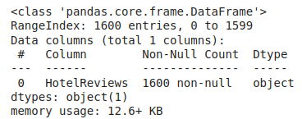
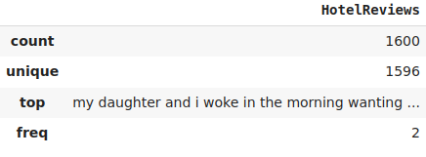
Part A — Data Analysis
Trip Advisor / MTurk / Hotels.com / Priceline / Expedia
Opinion Spam Training Data (n = 1600)
Positive Truthful
(n = 400)
Negative Truthful
(n = 400)
Positive Deceptive
(n = 400)
Negative Deceptive
(n = 400)
Notes:
We analyzed our dataset, comprised of reviews of 20 Chicago hotels. There are 1600 reviews total, evenly split between positive and negative, and between truthful and deceptive in each half. There are no null objects in the reviews, though there are 2 duplicates. We opted not to remove duplicates to maintain the balance in the data.

Slide 4
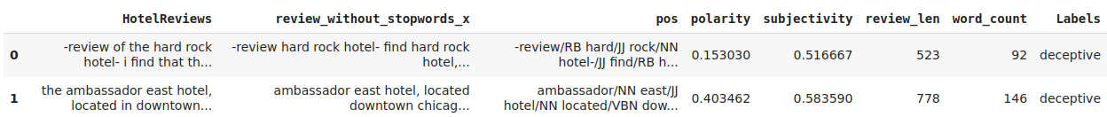
Part A — Data Cleaning & Preprocessing
Spelling check (pyspellchecker)
Lowercase
Removing stop words
Tokenization (unigrams/bigrams)
Part of speech tagging
Notes:
For data cleaning and preprocessing, we made sure to perform a spelling check, since we can’t analyze words correctly if they’re misspelled, especially with regards to things like frequency counts. For that we opted to use pyspellchecker.
[CLICK] We then make sure to remove stop words (common words with little value) from the corpus, making sure not to remove them in a way that changes the meaning of the reviews.

Slide 5
Part A — Data Cleaning & Preprocessing
Removing stop words (cautiously)
Extreme Negative
Review: Hotel is not very good. As per NLTK, Stop words are: is, very, not
Review after removing stop words: Hotel good
Positive
Notes:
We then make sure to remove stop words (common words with little value) from the corpus, making sure not to remove them in a way that changes the meaning of the reviews.

Slide 6
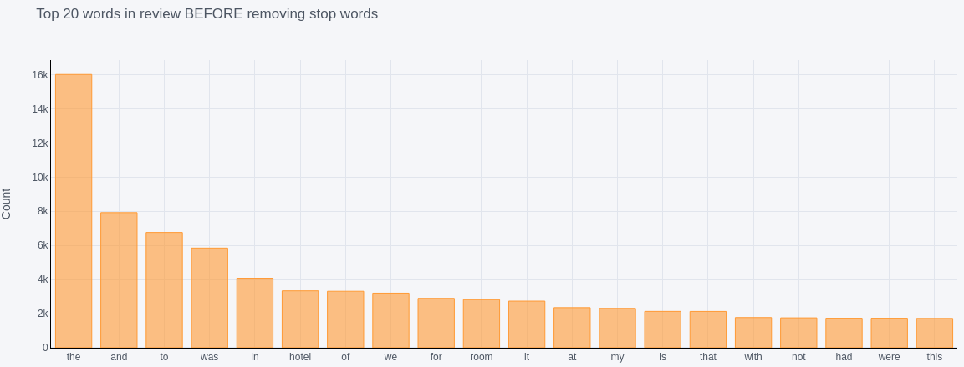
Part A — Data Cleaning & Preprocessing
High frequency words before stop-word removal
Notes:
[CLICK] And you can see the impact here of stop word removal - these are the highest frequency words before... [CLICK]

Slide 7
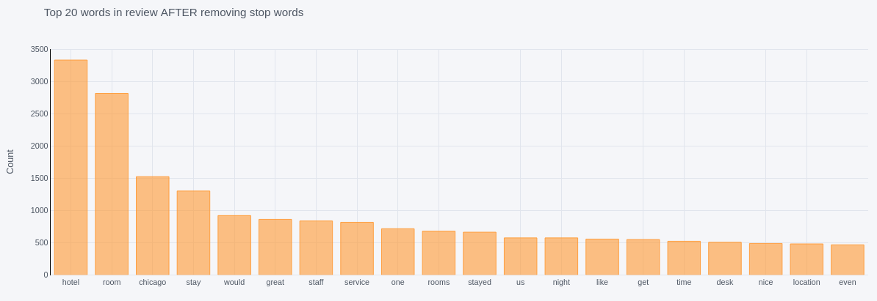
Part A — Data Cleaning & Preprocessing
High frequency words after stop-word removal
Notes:
[CLICK] and after removal.

Slide 8
Part A — Feature Selection
Bag of Words (N-gram Words) - Individual or n continuous words are used as a feature (we show Unigram and Bigram words during stop words calculation)
Term frequency - similar to bag of words with additional details of each word frequency
POS tagging - word tagging based on its definition and context
LIWC (Linguistic Inquiry & Word Count) - builds own dictionary to analyze the data - paid s/w
Stylometric - analyze writing style of the reviewer
Semantic - understand underlying meaning of the words and trains models accordingly
Review characteristics - metadata information on reviews - polarity, review length, etc.
Notes:
We considered many different potential that could be potentially useful. Bag of words or n-grams, term frequency…
Parts of speech tagging, tagging words as adjectives or adverbs, etc.
Linguistic inquiry and word count, using built dictionaries to classify dimensions of language
Stylometric features, essentially analyzing the writing style of the reviewer
Semantic features, aka the underlying meanings and concepts of words.
And then just review characteristics, metadata, like polarity of the review, review length.
We plotted some of these features to visualize them, so that we could pick the ideal ones, and we ended up going with these.

Slide 9
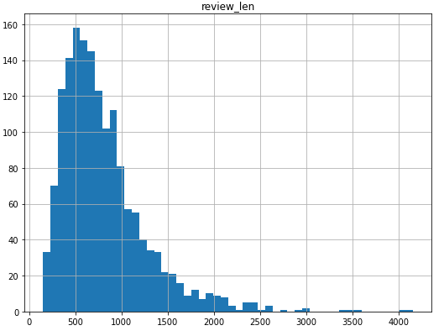
Part A — Feature Selection (Review Length)
All Reviews
Notes:
Just to quickly run through graphs This is the distribution for review length, by character.

Slide 10
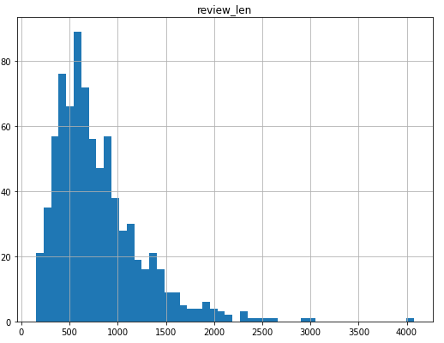
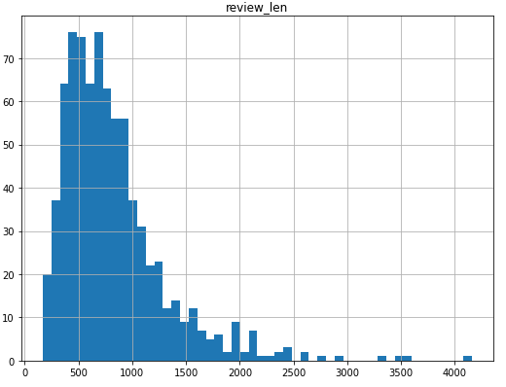
Part A — Feature Selection (Review Length)
Deceptive
Truthful
Notes:
Truthful reviews tend to have fewer characters, but there are more truthful reviews that are long, outliers in the 2500 to 4500 character range.

Slide 11
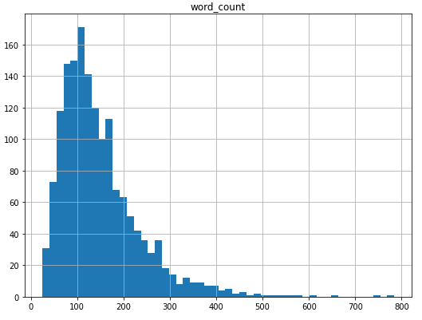
Part A — Feature Selection (Word Count)
All Reviews
Notes:
Word count: most reviews range from 80 to 150 words.

Slide 12
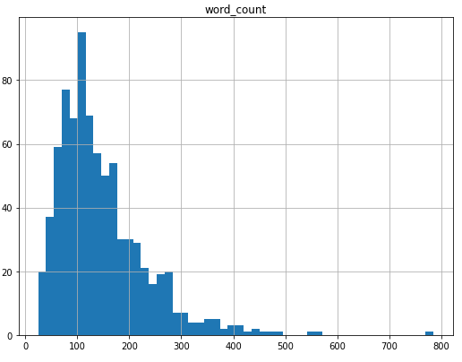
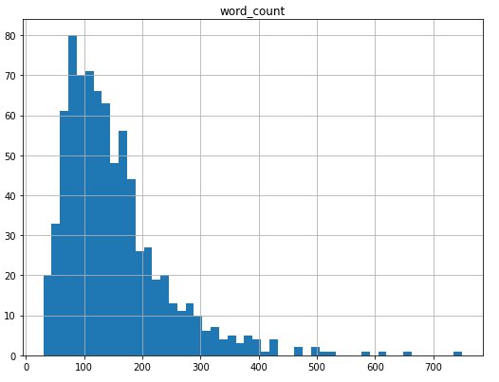
Part A — Feature Selection (Word Count)
Deceptive
Truthful
Notes:
Splitting again into deceptive and truthful; there are more truthful reviews in the 0-200 range, and in the greater than 500 word count range.
0-200 : truthful
truthful
200-300:deceptive
300-400:neutral
400-500:deceptive
>500 : truthful

Slide 13
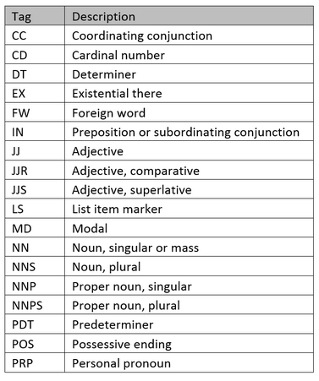
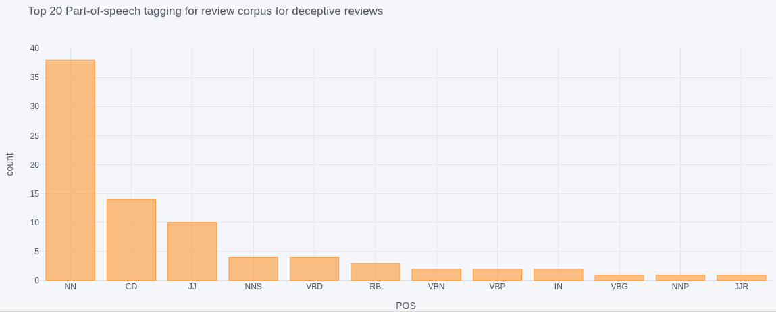
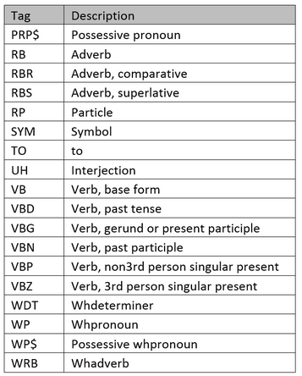
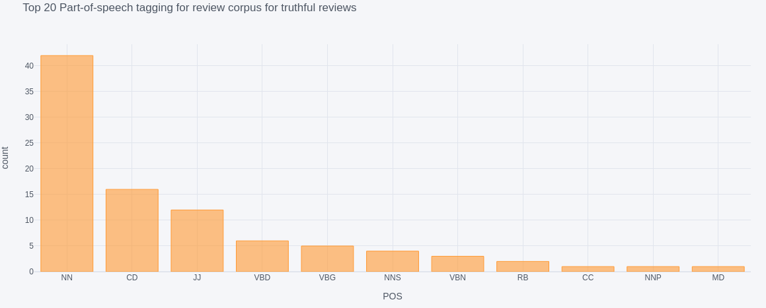
Part A — Feature Selection (POS Tagging)
Deceptive
Truthful
Notes:
With parts-of-speech tagging,
We can see that nouns, adjectives and cardinal numbers form the majority of the tags in both deceptive and truthful reviews, though as we go further down in frequency we see a bit of a split between deceptive and truthful.

Slide 14
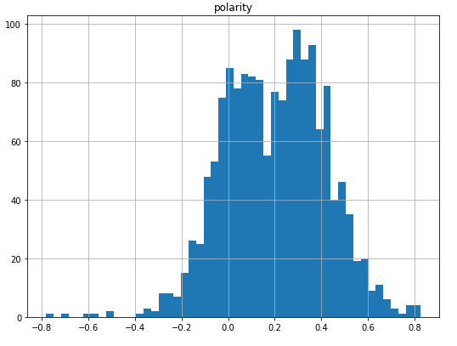
Part A — Feature Selection (Polarity)
All Reviews
Notes:
Polarity, in sentiment analysis, is just whether or not the sentiment of the review is positive or negative. We used TextBlob to analyze this.
Polarity in sentiment analysis refers to positive or negative sentiment in text... We used the the TextBlob package for this purpose. Here -1 represents a very negative sentiment and +1 represents a complete positive sentiment.
This distribution over all reviews has a positive skew. Therefore, we can infer that even the negative reviews are not very harsh.

Slide 15
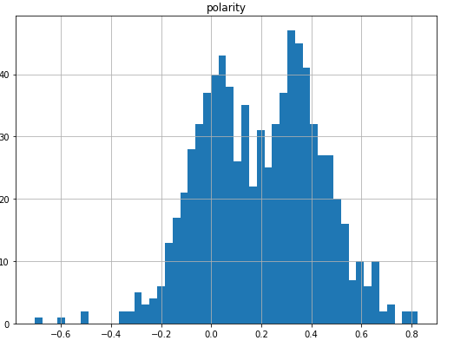
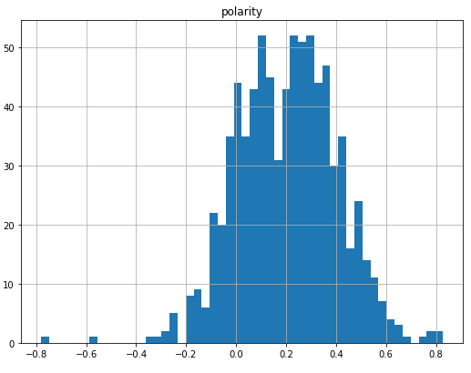
Part A — Feature Selection (Polarity)
Truthful
Deceptive
Notes:
Splitting into truthful and deceptive. Deceptive reviews have higher counts from -.4 to 0. And if we look at truthful reviews, we can infer that even negative truthful reviews won’t be incredibly negative in polarity.

Slide 16
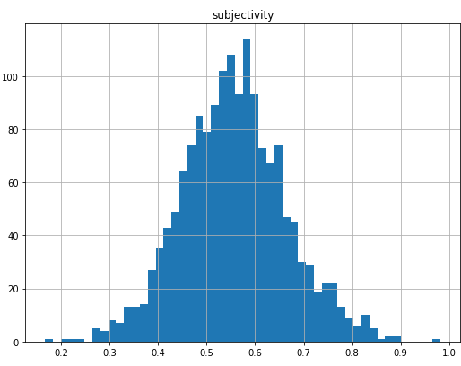
Part A — Feature Selection (Subjectivity)
All Reviews
Notes:
The next part of our sentiment analysis deals with subjectivity. It pertains to if the language is objective or subjective. Objective expressions are facts. Subjective expressions are opinions that describe people’s feelings towards a specific subject or topic.
In this graph, the subjectivity is a float value within the range 0 to 1. 0 is very objective and 1 is very subjective.
From this histogram, you can see that the reviews are more subjective. This is expected as people tend to share their opinions on reviews.

Slide 17
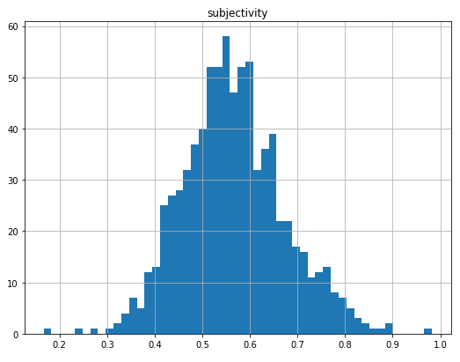
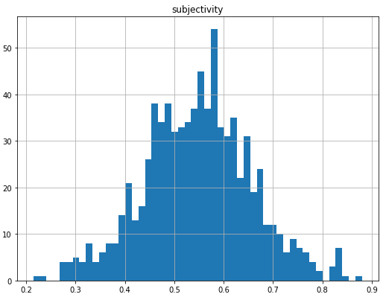
Part A — Feature Selection (Subjectivity)
Deceptive
Truthful
Notes:
Once again, we split our dataset.
On the left, we can see that the deceptive reviews have fewer number of reviews that are closer to 0, hence are more subjectivity. On the other hand, truthful reviews on the right, is more evenly split. So we can conclude that truthful reviews are more objective than deceptive reviews.

Slide 18
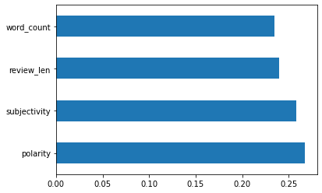
Part A — Feature Importance
Notes:
We measured and compared the relative importance of word count, review length, subjectivity and polarity by running the model on extraTreesClassifier. Amongst these 4 features, you can see that polarity has the highest value, indicating that it plays a bigger factor in determining the legitimacy of a review
model = ExtraTreesClassifier()
model.fit(X,y)
print(model.feature_importances_) #use inbuilt class feature_importances of tree based classifiers
#plot graph of feature importances for better visualization
feat_importances = pd.Series(model.feature_importances_, index=X.columns)
feat_importances.nlargest(10).plot(kind='bar')

Slide 19
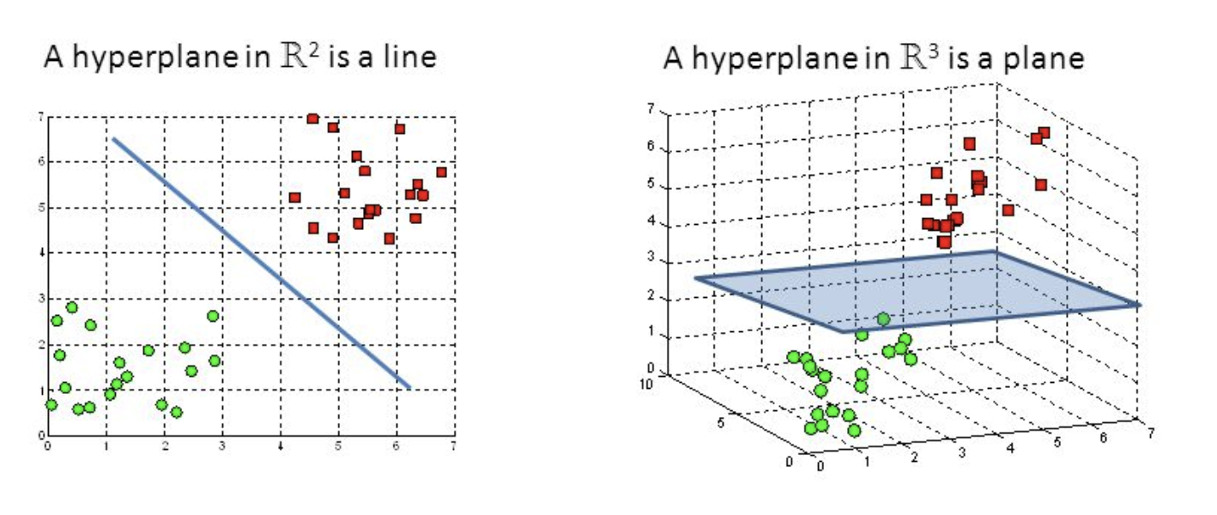
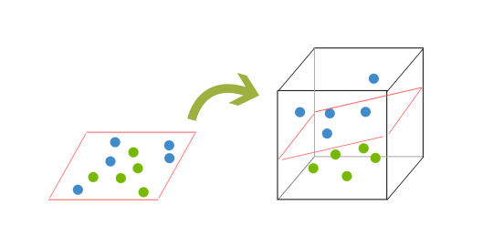
Part A — Model Selection
Support Vector Machines
Find a distinctly classifying hyperplane in N-space
Maximize margin
Support vectors
Critical data points near hyperplane
Accurate & efficient, but longer training time
Implementation
weight calculation using TF-Idf
Kernel method
Notes:
We analyzed a lot of research material to kind of narrow down what models have been successful in the past for this kind of data. And we decided on the following.
Support Vector machines

Slide 20
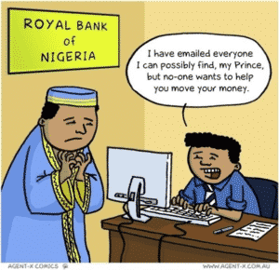

Part A — Model Selection
Naive Bayes
Bayes’ Theorem: probability of A after B
“Naive” - independence among predictors
“Nigerian Prince”, “fast money”, etc.
Simplistic but high-performing
Notes:
Naive Bayes classifier

Slide 21
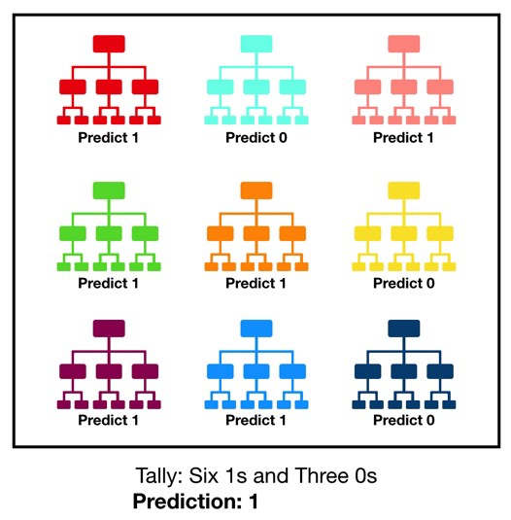
Part A — Model Selection
Random Forest
Decision Trees prone to overfitting
Power of committee
Bagging of dataset
Feature randomness
Notes:
Random Forest classifier That wraps up our review of part A. Let’s move on to part B, where we can dive into the details of our experimental trials

Slide 22
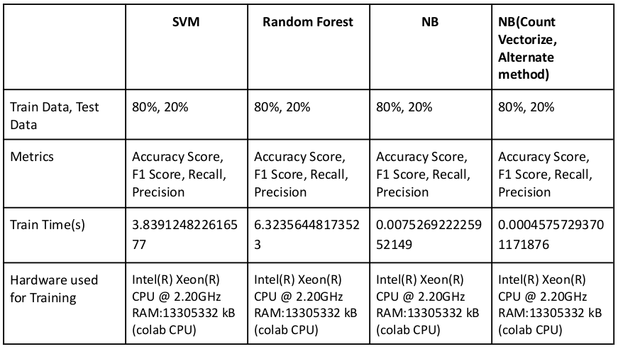
Part B - Experiment Settings

Slide 23
Part B - Experiment Settings ( Train-test Split )
80 - 20
Shuffle
5 runs
Notes:
Across the board, we split our data into 80% training and 20% test data.
When reading raw data, we were reading all truthful and deceptive reviews together, so machine will have first all truthful reviews and then all deceptive reviews. So, it will get train accordingly and may result in decline in the accuracy scores. So, during training, we made sure to shuffle the data to add randomness to get more accurate result. .
We used the average of 5 readings for every model. So the data was shuffled and split into 80:20 randomly 5 times.

Slide 24
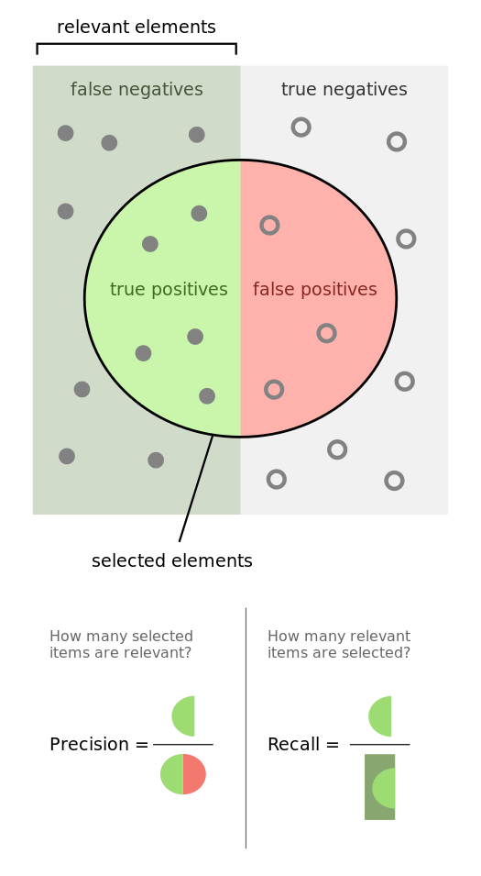



Part B - Experiment Settings ( Metrics )
Notes:
We used
Accuracy score
recall
precision, and
F1 score
Accuracy is calculated using number of correct predictions and total predictions.
Precision is calculated using the formula true positives / all positives. It tells us how valid the results are. Recall is calculated using the formula true positives / relevant elements. It tells us how complete the results are
The traditional F-measure or balanced F-score (F₁ score) is the harmonic mean of precision and recall and is calculated using the formula shown.

Slide 25
Part B - Experiment Settings (Hardware Used)
Google Colaboratory (also known as Colab) is a free Jupyter notebook environment
Jupyter word originally formed from the languages it supports - Julia, Python and R (but, currently it’s language agnostic and supports more language)
12 hours of continuous execution time in free version (Pro version available - paid)
Used CPUs for Final project
Commands used for finding hardware settings
!lscpu
!grep MemTotal /proc/meminfo
!df -h Magic: (!) - anything appearing after ! on a line will be executed not by the Python kernel, but by the system command-line.
Notes:
We have used Google colab for our code implementation using jupyter notebooks. As name suggests Jypeter notebooks were initially supporting languages like Julia, Python and R. But, currently it’s language agnostic and support more languages and the research in which Jypeter got created is continued with the name iPython. Google CoLab gives us different options for our notebook runtime. It does allow us to run multiple instances simultaneously, but the resources have to be shared between instances. And below, we have the commands we used to identify the hardware settings listed on the previous slide.

Slide 26
Part B - Experiment Settings (Hardware Used)
 | CPU | GPU | TPU
 | Central Processing Unit | Graphical Processing Unit | Tensor Processing Unit
Usage | Logics, Calculations, I/O of Computer, General purpose processor | CPU + additional processor to enhance Graphical interface to run high-end tasks | Powerful custom-built processors to run specific framework (e.g. Tensorflow)
Popular Manufactures | Intel, AMD, Qualcomm, NVIDIA, IBM, Samsung, Hewlett-Packard, VIA, | NVIDIA, AMD, Broadcom Limited, | Google (only)
Configuration | Intel(R) Xeon(R) CPU @ 2.20GHz, RAM: 13305324 kB | Intel(R) Xeon(R) CPU @ 2.20GHz, RAM: 13305324 kB | Intel(R) Xeon(R) CPU @ 2.30GHz, RAM: 13305324 kB
Notes:
This is the quick comparison between various run-time provided by Google colab. We ended up using just CPU instances, no GPU OR TPU acceleration, for our project code execution.

Slide 27
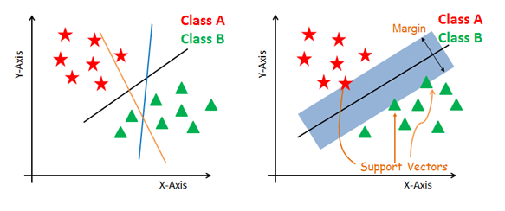
Part B - Training and Fine Tuning- 1
SVM Kernels
Linear
Polynomial
Radial basis function
Radial basis function
Have to find the hyperparameters c and gamma
C = 10 & gamma = 0.1
Why Linear?
Notes:
SVM needs to generate hyperplanes which segregates the classes in the best way. A kernel transforms an input data space into the required form. SVM uses a technique called the kernel trick. Here, the kernel takes a low-dimensional input space and transforms it into a higher dimensional space.
We had 3 options for the kernel. Linear, Polynomial and radial basis function.
We chose the Linear model after some reading. We read that the polynomial kernel is less useful for performance reasons.
We also tried the radial basis function kernel. We implemented gridsearch for different values of c and gamma and found that c = 10 and gamma = 0.1 gave the highest accuracy.
Buts its accuracy was only 1% higher than the linear model but it took 1.5 seconds more on average compared to the linear model.
So we decided to go ahead with the linear model.

Slide 28
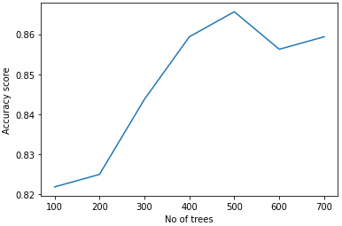
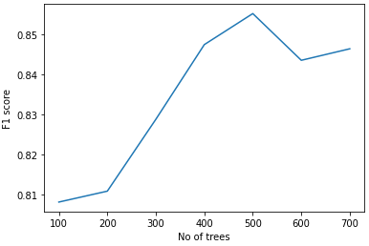
Part B - Training and Fine Tuning- 2
Finding # of trees for Random Forest (Team 9’s Magic number, n_estimators=500)
Notes:
Identifying the ideal number of trees (n_estimators), a hyperparameter is important to obtain
the highest accuracy and f1 score while using the Random Forest model. Therefore, we plotted graphs to
understand how the number of trees impacted Accuracy and F1 score. The graph on the left portrays how accuracy changes with respect to the number of trees and the one on the right shows how the F1 score changes. We saw that the scores where the highest when we used 500 trees. So we decided to use that value for training and testing raw data to get evaluation results.

Slide 29
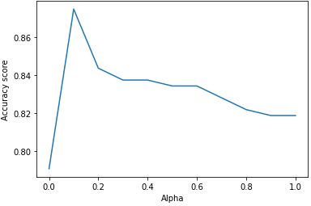
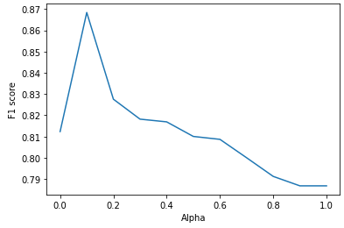
Part B - Training and Fine Tuning-3
Finding alpha for Naive Bayes (Team 9’s Magic number, alpha=0.1)
Notes:
Similarly, identifying the ideal alpha, a hyperparameter is important to obtain the highest accuracy and f1 score while using the Naive Bayes model. We plotted graphs to understand how alpha impacted Accuracy and F1 score. We saw that the values peaked when alpha was 0.1. So we decided to use that to train and test our model.

Slide 30
Part B-Evaluation Results (average of 5 runs) - Train Dataset
SVM, N-Gram Vectors
Average accuracy score 0.99296875
Average f1 score 0.9929632525410476
Average Training time 3.864674425125122
Average Recall 0.9968602825745683
Average Precision 0.9890965732087228
Naive Bayes, N-Gram Vectors - TF/IDF
Average accuracy score 0.99765625
Average f1 score 0.9976433621366849
Average Training time 0.009721755981445312
Average Recall 0.9968602825745683
Average Precision 0.9984276729559747
Random Forest, N-Gram Vectors
Average accuracy score 1.0
Average f1 score 1.0
Average Training time 6.1178144931793215
Recall 1.0
Precision 1.0
Naive Bayes, CountVectorize (Alternate method)
Average accuracy score 0.99765625
Average f1 score 0.9976433621366849
Average Training time 0.009721755981445312
Average Recall 0.9968602825745683
Average Precision 0.9984276729559747
Notes:
Similarly, we ran the models 5 times for the test dataset and got the results as shown.

Slide 31
Part B-Evaluation Results (average of 5 runs) - Test Dataset
SVM, N-Gram Vectors
Average accuracy score: 0.878125
Average f1 score: 0.8761904761904763 (87.61%)
Average Training time: 3.839124822616577
Average Recall: 0.8466257668711655
Average Precision: 0.9078947368421053
Naive Bayes, N-Gram Vectors - TF/IDF
Average accuracy score: 0.875
Average f1 score: 0.868421052631579 (86.84%)
Average Training time: 0.007526922225952149
Average Recall: 0.8098159509202454
Average Precision: 0.9361702127659575
Random Forest, N-Gram Vectors
Average accuracy score: 0.865625
Average f1 score: 0.8552188552188552 (85.52%)
Average Training time: 6.32356448173523
Recall: 0.7791411042944786
Precision: 0.9477611940298507
Naive Bayes, CountVectorize (Alternate method)
Average accuracy score: 0.865
Average f1 score: 0.85
Average Training time: 0.00045757293701171876
Average Recall: 0.8138297872340425
Average Precision: 0.8895348837209303
Notes:
We ran the models 5 times for the Test dataset using 500 trees for random forests and 0.1 as alpha for the Naive Bayes model and got the results as shown. We will compare these results in a moment.

Slide 32
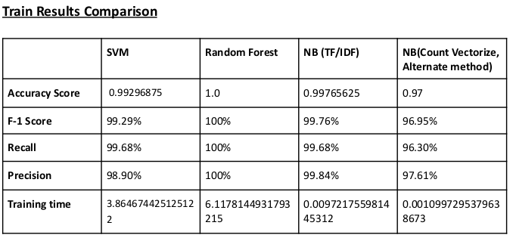
Part B - Comparison of machine learning models - 1
Notes:
To compare the different machine learning models, we took the average of 5 different runs, to improve the stability of our results. Here, you can see the scores for the training dataset.
Accuracy scores, f1 scores, recall, and precision, are all very, very high, as expected, since this is the data that is used to train the classifiers.
Accuracy scores tend to be in the range of 99 to 100%, and the same is true for recall and precision.
Naive Bayes had the shortest training time, completing in milliseconds, while SVM took almost 4 seconds. Naive Bayes being the fastest is in line with our expectations, because it is a very simple classifier.
One of the drawbacks of Random Forest is the need to use 500 trees to obtain an accuracy that is close to the other models. This results in it having the longest waiting time. However, the results for Random Forest on the train data is extremely high.

Slide 33
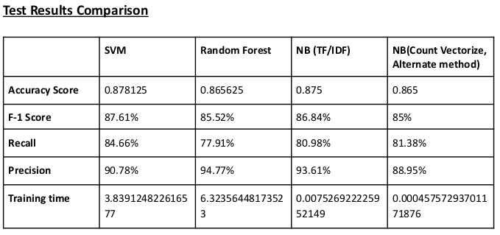
Part B - Comparison of machine learning models - 2
Notes:
Here, we have the results for runs on our test dataset.
Again, we’re taking the average of 5 runs to reduce noise.
SVM has an accuracy of 87.8% and an 87.6% F1 score.
Random forest has 86.5% accuracy, and an 85.5% f1 score.
And Naive Bayes has 87.5% accuracy, and 86.8% f1.
They’re all pretty close, although random forest had the poorest recall (less than 80), but the highest precision (almost 95%).
SVM had the best recall at 84%.

Slide 34
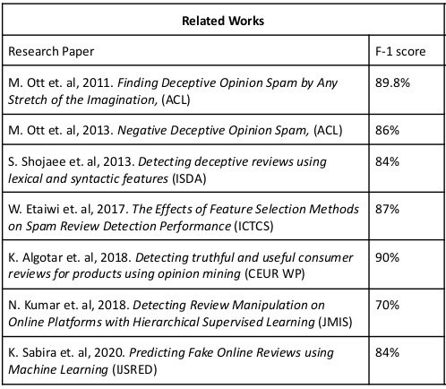
Part B - Comparison with related research - 1
SVM
F-1 Score: 87.61%
Notes:
We felt that a comparison with similar works is not advised due to the difference in the input data set. But since the models compared also work on opinions, a crude comparison is possible.
We were able to find the F1 score in these works. So we compared our F1 score with theirs.
We see that the team's Support Vector Machine model outperforms five out of the seven works we encountered.

Slide 35
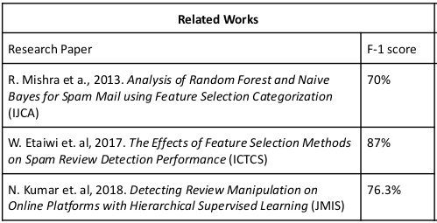
Part B - Comparison with related research - 2
Random Forest
F-1 Score: 85.52%
Notes:
And Our random forests' F1 score was higher than two out of three studies we came across.

Slide 36
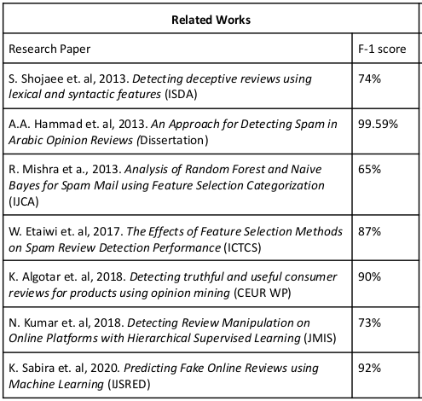
Part B - Comparison with related research - 3
Naive Bayes (TF/IDF)
F-1 Score: 86.84% NB (Count Vectorize, Alternate method) F-1 Score: 85.00%
Notes:
Similarly, our Naive Bayes model performs better than three out of seven models. Also, in our implementation of NB with TF/IDF and vectorization method, TF/IDF implementation has higher F-1 score.

Slide 37
Part B - Findings and conclusion
SVM: Highest F-1 score and Recall
NB: Second highest F-1 score
Random Forest: third highest F-1 score, but highest precision
500 trees to get compatible result -> longest wait time but train data has the highest result
Comparison (Related Works)
SVM better than 4/7
NB better than 3/7
Random Forest better than 2/3
Notes:
To reiterate what we have discussed.
We see that SVM has the highest accuracy, F1-score and Recall amongst all models.
Naive Bayes performs second, followed by Random Forest.
Random Forest has the highest precision compared to all the models but it needed to use 500 trees to obtain an accuracy that is close to the other models therefore has the longest training time. But it has the best results on train data.
And on this slide, we can also see how our implementation performs when compared to others.

Slide 38
Reference
Aslam, U., Jayabalan, M., Aziz, H., & Sohail, A. (2019). A Survey on Opinion Spam Detection Methods. International Journal of Scientific & Technology Research, 8, 1355-1363.
Hussain, N., Turab Mirza, H., Rasool, G., Hussain, I., & Kaleem, M. (2019). Spam Review Detection Techniques: A Systematic Literature Review. Applied Sciences, 9(5), 987. https://doi.org/10.3390/app9050987
Zhang, W., Du, Y., Yoshida, T., & Wang, Q. (2018). DRI-RCNN: An approach to deceptive review identification using recurrent convolutional neural network. Information Processing & Management, 54(4), 576-592. https://doi.org/10.1016/j.ipm.2018.03.007
Lai, S., Xu, L., Liu, K., & Zhao, J. (2015). Recurrent Convolutional Neural Networks for Text Classification. In Proceedings of the Twenty-Ninth AAAI Conference on Artificial Intelligence, 2267–2273.
Stanton, G., & A. Irissappane, A. (2019). GANs for Semi-Supervised Opinion Spam Detection. In Proceedings of the Twenty-Eighth International Joint Conference on Artificial Intelligence, IJCAI-19, 5204–5210.
Crawford, M., Khoshgoftaar, T., Prusa, J.D., Richter, A.N. & Al Najada, H.(2015). Survey of review spam detection using machine learning techniques. Journal of Big Data, 2, 1-24. https://doi.org/10.1186/s40537-015-0029-9
Ott, M., Choi, Y., Cardie, C., & Hancock, J.T. (2011). Finding Deceptive Opinion Spam by Any Stretch of the Imagination. In Proceedings of the 49th Annual Meeting of the Association for Computational Linguistics: Human Language Technologies, 309–319.

Slide 39
Reference
Ott, M., Cardie, C., & Hancock, J.T. (2013). Negative Deceptive Opinion Spam. In Proceedings of the 2013 Conference of the North American Chapter of the Association for Computational Linguistics: Human Language Technologies, 497-501.
freeCodeCamp.org. (2018, March 23). An introduction to part-of-speech tagging and the Hidden Markov Model. freeCodeCamp.org. https://www.freecodecamp.org/news/an-introduction-to-part-of-speech-tagging-and-the-hidden-markov-model-953d45338f24/.
GeeksforGeeks. (2020, November 24). Removing stop words with NLTK in Python. GeeksforGeeks. https://www.geeksforgeeks.org/removing-stop-words-nltk-python/.
(2021, April 9). Text Classification: All Tips and Tricks from 5 Kaggle Competitions: Neptune Blog. neptune.ai. https://neptune.ai/blog/text-classification-tips-and-tricks-kaggle-competitions.
Bhargava, R., Baoni, A. & Sharma, Y. (2019). Composite Sequential Modeling for Identifying Fake Reviews. Journal of Intelligent Systems, 28(3), 409-422. https://doi.org/10.1515/jisys-2017-0501
Shojaee, S., Murad, M., Azman, A., Sharef, N., & Nadali, S. (2013). Detecting deceptive reviews using lexical and syntactic features. In Proceedings of the 13th International Conference on Intellient Systems Design and Applications, 53-58. https://doi.org/10.1109/ISDA.2013.6920707
Hammad, A.A., & El-Halees, A. (2015). An Approach for Detecting Spam in Arabic Opinion Reviews. International Arab Journal of Information Technology, 12(1), 9-16. https://doi.org/20.500.12358/20125

Slide 40
Reference
Mishra, R., & Thakur, R.S. (2013). Analysis of Random Forest and Naive Bayes for Spam Mail using Feature Selection Catagorization. International Journal of Computer Applications, 80, 42-47. https://doi.org/10.5120/13844-1670
Etaiwi, W., & Awajan, A. (2017). The Effects of Features Selection Methods on Spam Review Detection Performance. In Proceedings of the 2013 Research in Adaptive and Convergent Systems, 116-120. http://doi.org/10.1109/ICTCS.2017.50
Algotar, K., & Bansal, A. (2018). Detecting truthful and useful consumer reviews for products using opinion mining. CEUR Workshop Proceedings, 2111, 63-72.
Kumar, N., Venugopal, D., Qiu, L., & Kumar, S. (2018). Detecting Review Manipulation on Online Platforms with Hierarchical Supervised Learning. Journal of Management Information Systems, 35, 350-380. http://doi.org/10.1080/07421222.2018.1440758
Sabira, K., & Kiruthiga, G. (2020). Predicting Fake Online Reviews Using Machine Learning. International Journal of Scientific Research and Engineering Development, 3(2), 269-273.

Slide 41
Individual contributions - 1
Siddharth Sheth (UW ID:shethsid, Student ID: 2076180)
Reading files and creating dataframes.
Visualization for the unigrams and bigrams
Read research papers for model selection
Support Vector Machine model
Patrick Moy (UW ID:moyp, Student ID: 1841305)
Sentiment analysis
Part of Speech tagging
Compiled the team's notes on research papers and made the final recommendation
Random forest model
Srivatsav Gopalakrishnan ( UW ID: sgopal9, Student ID:2075414)
Spell check and Stop words
Histograms for the dataset.
Read research papers for model selection
Naive Bayes Model
Notes:
Sidharth :
We usually use group programming sessions and have one person lead, while the other two follow and help steer, which is why we have all our tasks split. Research papers are divided among us for surveying.
I lead the work on reading file and creating dataframes.
Then I helped in visualization for the the unigrams and bigrams,
Srivatsav:
I did the part on spellcheck, stop words and histograms. Read few papers on the different models. And implemented the naive bayes model.
Patrick
Mostly worked on sentiment analysis and part of speech tagging. I also compiled our group notes from the research papers we referenced, evaluated them by journal and conference ranking, and made the final recommendations for model selection.

Slide 42
Individual contributions - 2
Tasks (each task considered as 100% for effort distribution) | Siddharth | Srivatsav | Patrick
Reading file and creating dataframe | 60 | 20 | 20
Stop words | 20 | 50 | 30
Visualization (Histogram and Analysis) | 20 | 60 | 20
Sentiment Analysis | 30 | 20 | 50
Unigrams and bigrams | 50 | 30 | 20
Part of speech tagging | 20 | 20 | 60
Feature selection and importance | 40 | 30 | 30
Survey of machine learning models | 30 | 30 | 40

Slide 43
Questions?
Thank you for your time!
(~Team 9)

